Slide 1
Social Media Management

Slide 2
About me
Social Media Manager at Telegrafi.com
Co-Founder of Maniakat
Volunteer

Slide 3
Agenda
Introduction to social media
Social media for organizations
Creating a Social Media Strategy
Planning content distribution
Facebook Page Insights & Tools & Ads
Instagram and Twitter
Case Study (Libra me zë)

Slide 4
Introduction to social media
What is social media?
Social media is an internet-based form of communication. Social media platforms allow users to have conversations, share information and distribute content.
There are many forms of social media, including blogs, wikis, social networking sites, photo-sharing sites, instant messaging, video-sharing sites, and more.
Where does Kosovo stand on social media?
1,000,000 Monthly Active Users On Facebook
580,000 Monthly Active Users On Instagram
32,000 Monthly Active Users On Linkedin
1 Milion Internet Mobile Users In Kosovo
Source: HALLAKATE.com

Slide 5
Social media for organizations
The impact of Social Media in Organizations
Social media is a great opportunity for organizations to tell their story, engage with supporters and get results.
Your organization can use social media to
Get new volunteers
Inform volunteers for upcoming activities
Educate community
Increase awareness of your organization
Fundraising
Partner with other organizations

Slide 6
Social media for organizations
Get new volunteers
Identify your target audience
Choose the right channels to reach your potential volunteers
Create a relevant content

Slide 7
Creating a Social Media Strategy
Setting social media goals is very important for your organization. You have to determine what you want to achieve through social channels, these are some factors that you can plan for.
Increase brand awareness
Get people to visit your website
Get new volunteers
Get donations
Build a community
Get better press mentions

Slide 8
Planning content distribution
Why do you want people to read your content?
Who is your audience?
How does your audience consume content?
Define your timeframe

Slide 9
Facebook Page Insights
What you should be looking for in Page Insights?
Facebook’s page insights tool allows you to easily track the performance of your organizations Page.
You can measure likes, engagement, reach, and demographics
Facebook Insights gives you a clear picture of where your social strategy stands. Providing clarity and perspective, Facebook Insights is like a good set of windshield wipers to help you navigate your social media plan.
Likes
Reach
Page Views
Posts
People
Messages

Slide 10
Facebook Ads
How can your organization use Facebook Ads to reach your goals?
Ads are particularly useful if you want to reach new people on Facebook or show your message to specific audiences. You can run ads on almost any budget.
Find new supporters by reaching outside your existing community
Reach out to people who are similar to your existing supporters
Make sure more of your audience sees an important post
Send calls to action to people with particular demographics, interests or behaviors
Drive specific behaviors, like visiting your website or signing up for your email list

Slide 11
Instagram
How can your organization use Facebook Ads to reach your goals?
Ads are particularly useful if you want to reach new people on Facebook or show your message to specific audiences. You can run ads on almost any budget.
Before anything else, you have to commit
Use Instagram stories
Try which kind of content is working best
Tell a story
Call your visitors to action
Highlight upcoming volunteer opportunities

Slide 12
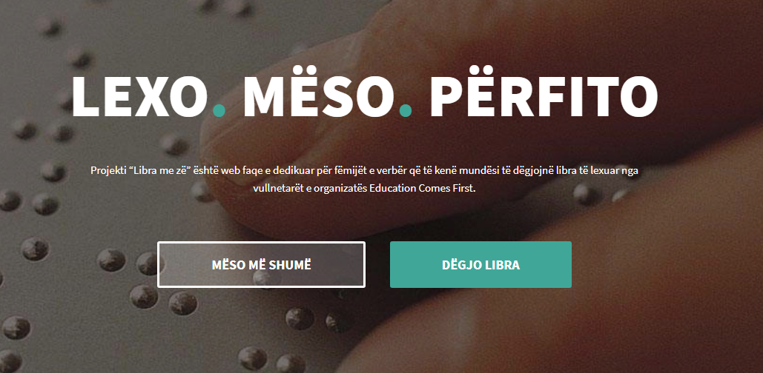
Case study: Libra me zë
How we got the idea, volunteers, funds and partners through social media.

Slide 13
That’s all folks 😃
Questions?
Linkedin: Egzon Bunjaku
Facebook: Egzon Bunjaku
Twitter: @egzonche

